Slide 1
How the End Preparations of Concrete Cylinders Affect its Measured Strength
Carley Rizzo
Colorado State University Global
MIS581: Capstone – Business Intelligence and Data Analytics
Dr. Lisa Bryan
December 4, 2022

Slide 2

Presentation Outline
Figure 1
ASTM International Logo
The Problem Background
The Research Question
Datasets in Focus
Research Methodology
Statistical Testing Hypotheses and Findings
Recommendations
Note. Adapted from Google Images.

Slide 3
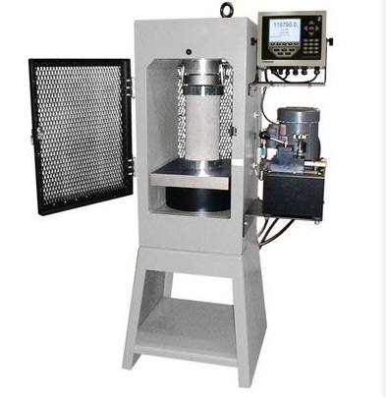
The Problem Background
Figure 1
ASTM International Logo
Figure 2
Concrete Compression Machine
Note. Adapted from Google Images.
American Society for Testing and Materials (ASTM International) publishes concrete standards concrete laboratories are required to follow
Concrete compressive strength standard specifies five possible end preparation methods for testing concrete cylinders
Note. Adapted from Google Images.
Notes:
We will begin by providing background information to build the foundation for this research project. American Society for Testing and Materials (ASTM International) is a standard making company that produces thousands of standards that cover a wide range of products, one being the concrete industry. ASTM International’s concrete testing standards are globally recognized standards that concrete laboratories in the US are required to follow in order to legally test concrete. While most ASTM standards only provide one correct way to perform the procedure, one particular concrete standard includes five different methods for preparing the ends of a concrete cylinder to test its compressive strength; claiming that they all yield the same results, despite their differences in procedural approach (ASTM International, 2021).
The standard in question uses the equipment photographed here, which is called a compression machine. The cylinder is placed into this machine, and the platens come into contact with the cylinder and apply a force until the cylinder fractures, and the strength of the concrete is recorded. The platens within the compression machine are steel, but under thousands of pounds of force, can become malleable over time. The ASTM standard specifies the platens remain plane to 0.001 inches and anything that touches the platens be plane to 0.002 inches (ASTM International, 2021). A hardened concrete cylinder is never plane to 0.002 inches on its own, and thus one of the five end preparations must be used.

Slide 4
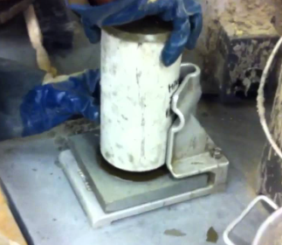
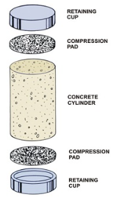
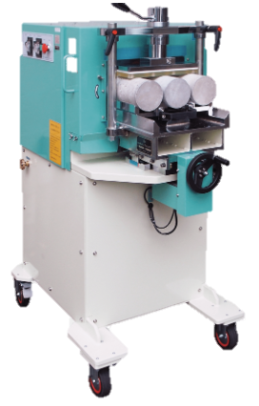
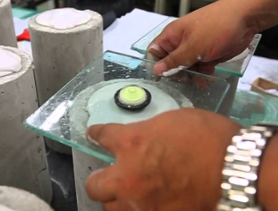
End Preparation Methods in Focus
Figure 5
Sulfur Capping (top), Gypsum Capping (bottom)
Figure 3
Unbonded Caps
Figure 4
Cylinder Grinder
Note. Adapted from Google Images.
Note. Adapted from Google Images.
Note. Adapted from Google Images.
Notes:
Taking a closer look at the five end preparations methods, the first method illustrated is the unbonded cap method. The cylinder is seated within the steel retaining cups pictured and neoprene pads are used as the cushions. Unbonded caps are the preferred method due the equipment being reusable, and there is no waiting period to testing. The next method illustrated is grinding, where the cylinders are placed in the machine, and diamond-impregnated steel blades lap the cylinder ends to be plane to the specified 0.001 inches (Graybeal, 2015). This method is not as popular due to the equipment costing upwards of hundreds of thousands of dollars. The upper photo illustrates sulfur capping, where the sulfur is heated to between 265 and 290 degrees Fahrenheit and the cylinder is placed in a pool of sulfur using a capping plate (ASTM International, 2015). The bottom photo illustrates gypsum capping, where the powdered gypsum is mixed with water and the paste is applied to the top of the cylinder using a greased glass plate and bubble level. The fifth end preparation method not pictured here is the cement paste method. This method is extremely uncommon and occurs when the cylinder is freshly made.
Each of these five methods are drastically unique, yet it is curious they all claim to yield similar strength results. Now that we have a good background as to what we will be discussing, we can put the research question into focus.

Slide 5
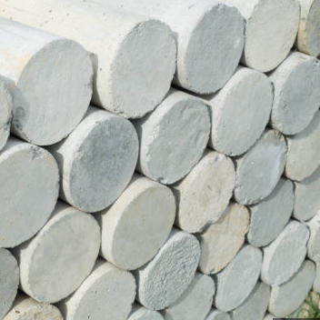
The Research Question
Figure 6
Stack of Concrete Cylinders
Does the end preparation of a concrete cylinder have an effect on its reported compressive strength?
Note. Adapted from Google Images.
Notes:
Articulating a quantitative research question consists of being mindful of the affected population, considering the exposure variable in question, and determining the impact of the research outcome (Mitchell et al., 2020). A research question must be clear, concise, realistic, and have an actionable impact on its area of study. Thus, our declared research question is: does the end preparation of a concrete cylinder have an effect on its reported compressive strength? Another way to look at this question is to ask: is the ASTM standard accurate that any of the five end preparation methods can be used, and it will have no affect on the concrete’s reported compressive strength?

Slide 6
The Datasets to Use
Overall Metrics:
Sample: Laboratories across the US
Standardized materials shipped to all participants
Same compressive strength standard followed
Reported strength results and which end preparation used
Data gathered in Spring and Fall of 2018
With 2,751 total observations, no laboratory chose the cement paste method
Figure 7
Survey Question
Which end preparation method was used on the cylinders for testing?:
Unbonded Caps
Sulfur Caps
Gypsum Caps
Grinding
Cement Paste
Other (Please Specify):
Note. Created within Microsoft PowerPoint.
Notes:
With the research question declared, the next step was to gather the data to evaluate the research question. The concrete division of ASTM International ships regulated concrete material samples out to all participating US laboratories, where they perform a number of ASTM standards on the concrete material, and submit their results to see how they compare to the rest of the nation’s results. In 2018, two samples were shipped out, once in the spring and once in the fall. The laboratories tested the concrete according to the ASTM standard in question, and submitted their answer to the survey question displayed in the Figure. According to O’Leary (2021), survey data gathers strong quantifiable data, but if not designed correctly, can be a challenge to clean and get healthy participation numbers. There were a small number of laboratories that did not answer the survey question, and those observations were disregarded for this research. A number of laboratories wrote in the “other” section, meaning significant data cleaning was needed; however, this was completed in a timely manner. Finally, after compiling all of the usable data and running basic descriptive statistics, it was revealed that out of the total 2,751 observations that no laboratory chose the cement paste method. Thus, the cement past method was omitted from the analysis.

Slide 7
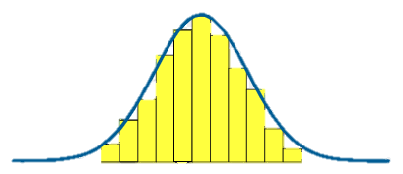
How Were the Datasets Tested?
Methodology:
Datasets extensively cleaned
Several hypothesis statements were declared
Null Hypothesis
Alternative Hypothesis
Two statistical tests used:
Paired T-test
Analysis of Variance (ANOVA) Testing
P-Value of 0.05 used for all testing
Figure 8
Normal Distribution Visualization
Note. Adapted from Google Images.
Notes:
Thus far, we have discussed the background of the ASTM concrete compressive strength standard, and why it is being questioned for this research project. Then, the five possible end preparation methods were illustrated to put the problem properly into focus. Next, we formerly declared the research question, and described the parameters of the datasets that were used to evaluate the research question.
The remaining slides of this presentation will dive into the evaluation methods of the gathered datasets and report on their findings. The first statistical test run on the datasets was a paired t-test, and those results were taken into account when running the second statistical test called an ANOVA test. Each statistical test required a set of hypothesis statements, which consist of a null hypothesis, what the research is negating, and an alternative hypothesis, what the research is trying to prove (McNulty, 2022). Both statistical test results were assessed using a p-value which, “measures how likely it is that any observed difference between groups is due to chance” (Erdogdu et al., 2020, p.15). This research used a p-value of 0.05 for each statistical test completed, and the returned values were used to select the hypothesis statement outcome. The first statistical test we will discuss is the paired t-test.

Slide 8
Paired T-Test Hypothesis
The Null Hypothesis H_{o} : There is no statistically significant difference between spring and fall samples.
The Alternative Hypothesis H_{A}: There is a statistically significant difference between spring and fall samples.
Applied in the following ways:
Unbonded Capping
Sulfur Capping
Gypsum Capping
Grinding Cylinder Ends
Collectively
Notes:
As explained in the previous slide, a hypothesis statement must be made for each statistical test. The hypothesis statement for the paired t-test is displayed here stating that the null hypothesis is where there is no statistically significant difference between the spring and fall samples, and the alternative hypothesis is where there is a statistically significant difference between the spring and fall samples. This hypothesis statement structure was applied to the spring and fall datasets in a total of five ways, listed here. Each of the four end preparation methods included in the analysis as well as both datasets in their entirety were examined.
What is a paired t-test? A paired t-test compares the means of two similar datasets, commonly over a span of time, to determine if they are statistically similar (Yusop et al., 2015). Thus, each of the four end preparations will have their own mean compressive strength value, and these means will be tested for significance, as well as the overall means. If the datasets are found to be statistically similar, meaning a failure to reject the null hypothesis, they can be combined into a single set for additional analysis purposes. Let’s take a look at the results on the following slide.

Slide 9
Paired T-Test Results
Table 1
Paired T-Test Results
End Preparation | N | Mean Difference | Standard Deviation | P-Value | Hypothesis Conclusion
Unbonded Caps | 1348 | 286.6 | 478.8 | < 0.0001 | Reject H₀
Sulfur Caps | 185 | 251.9 | 494.2 | < 0.0001 | Reject H₀
Gypsum Caps | 5 | 469.0 | 331.6 | 0.0341 | Reject H₀
Grinding | 58 | 208.6 | 508.8 | 0.0028 | Reject H₀
Spring/Fall Total | 1366 | 284.8 | 483.6 | < 0.0001 | Reject H₀
Note. Created within Microsoft PowerPoint.
All five conclusions Reject Null Hypothesis
There is a statistically significant difference between the two datasets
Datasets kept separate for all future evaluations
Notes:
Taking a look at the table, each row is broken down into the five paired t-tests that were ran on the two datasets, and their respective results. It’s always important to take a look at the descriptive statistics consisting of the sample sizes, N, the means and standard deviations to learn the parameters of the datasets. Here we see that the unbonded cap method was clearly the most popular method chosen by the laboratories with over 1,300 observations, and we see that the gypsum capping method is easily the least selected method. However, even with these differences, in the P-Value column, all outcomes are significantly smaller than our threshold p-value of 0.05. Thus, the rightmost column displayed the hypothesis outcome that all five paired t-tests rejected the null hypothesis. This means that we can say there is a statistically significant difference between the spring and fall datasets. With these datasets being considered statistically different, they cannot be combined into a single set for additional analysis purposes.

Slide 10
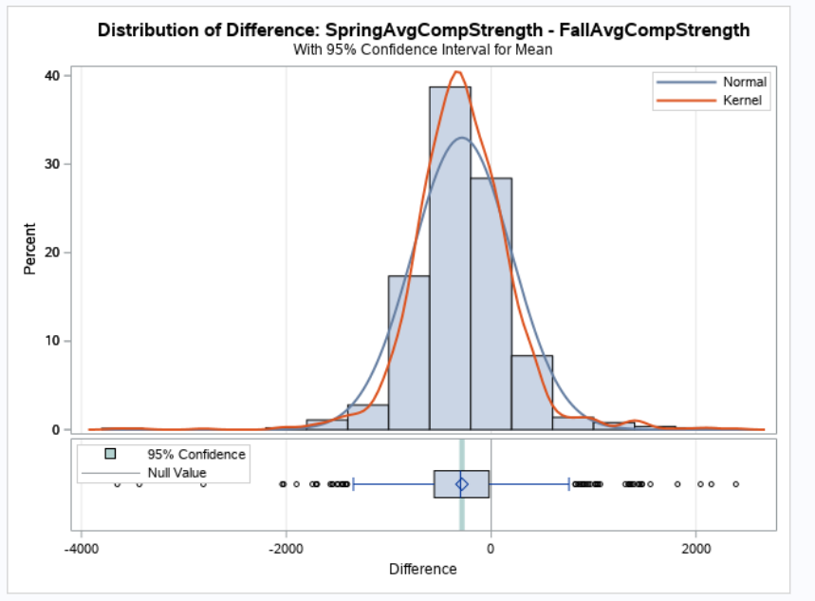
Paired T-Test Distribution
Figure 9
Paired T-Test Spring and Fall Samples
Follows a normal distribution
Confident in results
Note. Adapted from SAS Studio.
Notes:
It is always important to verify the validity of the results of a statistical test. For a paired t-test, this is accomplished through ensuring the sample follows a normal distribution. If a sample is normally distributed, then we can be statistically confident in the paired t-test results. The graph here illustrated the distribution of both the spring and fall datasets, and this is a fairly normal distribution. We can see the bell curve heighten in a centralized location, the spread is fairly symmetrical on either side of the curve, and both tails of the curve have outliers, the left more so than the right, but no additional spikes. Thus, we can be confident in the paired t-test results, and will keep the spring and fall datasets separate for the second statistical test, the ANOVA test.

Slide 11
ANOVA Testing Hypothesis
The Null Hypothesis H_{o} : There is no statistically significant difference in a concrete cylinder’s compressive strength using unbonded caps, sulfur capping, gypsum capping, or grinding cylinder ends.
The Alternative Hypothesis H_{A}: There is a statistically significant difference in a concrete cylinder’s compressive strength when using unbonded caps, sulfur capping, gypsum capping, or grinding cylinder ends.
Applied in the following ways:
Spring Sample
4x8 cylinder size
6x12 cylinder size
Fall Sample
4x8 cylinder size
6x12 cylinder size
Notes:
The second statistical tool used to evaluate the gathered datasets and answer the proposed research question is an ANOVA test. ANOVA testing is used to compare the mean values between independent events through a single related variable (Erdogdu et al., 2020). This statistical test is ideal for our research question and datasets since each end preparation method is an independent event, yet they all produce a compressive strength value. Each of the four end preparation methods will have their own mean compressive strength value that can be statistically compared to one another with the ANOVA test. The null hypothesis statement is that there is no statistically significant difference in a concrete cylinder’s compressive strength using unbonded caps, sulfur capping, gypsum capping, or grinding cylinder ends. The alternative hypothesis statement is that there is a statistically significant difference in a concrete cylinder’s compressive strength when using unbonded caps, sulfur capping, gypsum capping, or grinding cylinder ends.
This hypothesis statement was applied to the spring and fall datasets separately and further partitioned by the cylinder size tested. Thus a total of four ANOVA tests were completed, and the results are displayed on the following slide.

Slide 12
ANOVA Testing Results
Table 2
ANOVA Test Results
Sample | End Preparation Method | N | Mean | Standard Deviation | P-Value | Hypothesis Conclusion
Spring 4x8 | Grinding | 30 | 4470.8 | 259.7 | 0.7561 | Fail to Reject H₀
 | Gypsum | 1 | 4675.0 | -
 | Sulfur | 60 | 4479.6 | 330.9
 | Unbonded | 1051 | 4512.6 | 340.3
Spring 6x12 | Grinding | 3 | 4253.3 | 201.8 | 0.6065 | Fail to Reject H₀
 | Gypsum | 1 | 4095.0 | -
 | Sulfur | 44 | 4205.9 | 274.0
 | Unbonded | 193 | 4148.5 | 286.6
Fall 4x8 | Grinding | 21 | 4568.3 | 699.6 | 0.0072 | Reject H₀
 | Gypsum | 3 | 4945.0 | 295.1
 | Sulfur | 53 | 4723.9 | 324.5
 | Unbonded | 1043 | 4812.3 | 360.7
Fall 6x12 | Grinding | 4 | 4417.5 | 137.5 | 0.9468 | Fail to Reject H₀
 | Gypsum | 1 | 4280.0 | -
 | Sulfur | 42 | 4452.4 | 301.4
 | Unbonded | 199 | 4437.9 | 310.9
Note. Created within Microsoft PowerPoint.
Notes:
Taking a look at the table, the four rows represent the four ANOVA tests completed, and the results are further illustrated and broken down by the end preparation method. This helps to compare and contrast each of the four ANOVA tests. Similarly to the paired t-test results, each of the evaluations display the unbonded cap method as the most popular method, and gypsum capping being the least favorable method. The means are all generally in the same ballpark, and there appears to be a larger variance in the standard deviation. Some peculiar results in the p-value column show extremely high p-values in three of the four results, and one p-value less than the 0.05 threshold value in the fall 4x8 sample. This means that at face value, three of the four results lead to the rightmost column reporting a failure to reject the null hypothesis, meaning there is no statistically significant difference between the end preparation compressive strength averages. Since the fall 4x8 sample returns a statistically significant p-value, the hypothesis conclusion is to reject the null hypothesis, meaning at least one end preparation method produced a statistically significant different compressive strength average.

Slide 13
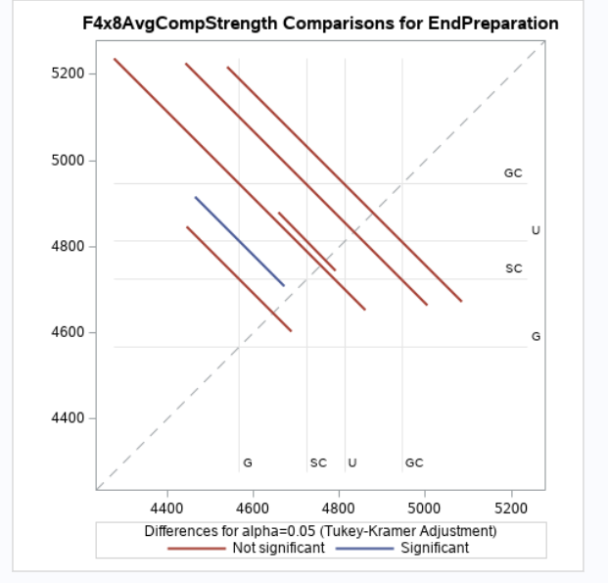
Fall 4x8 Sample Graph from ANOVA Testing
Figure 10
Fall 4x8 End Preparation Comparison Graph
Legend:
G = Grinding
SC = Sulfur Capping
U = Unbonded Caps
GC = Gypsum Capping
Findings:
Statistically significant difference between grinding (G) and using unbonded caps (U)
Note. Adapted from SAS Studio.
Notes:
Taking a further look into the fall 4x8 sample results, the graph here compares each of the four end preparation methods to each other and visualizes the significance of their relationship. The dotted diagonal line represents a 95% confidence interval for the difference between the two method’s means. The red lines crossing the dotted line mean the relationship is not significant, while the blue line not crossing the dotted line signifies a statistically significant relationship. Following the legend, the graph is displaying a statistically significant relationship between the grinding and unbonded cap methods, claiming the unbonded caps return statistically higher compressive strength values compared to grinding.
Narrowing the focus on the graph to the bottom point of the blue line, it appears to be extremely close to that 95% confidence interval line, which would turn the line red and declare the relationship not statistically significant. Flipping back to the previous slide, an evident issue lies within the difference in sample sizes. For the fall 4x8 sample, grinding had just 21 observations, compared to the 1,043 unbonded cap observations. As the difference in sample sizes increases, the margin for error greatly increases as well (Fitts, 2010). With such a large difference in sample sizes, the statistically significant result that the unbonded caps produce a higher average compressive strength value compared to grinding the cylinder ends is cautiously noted. Therefore, even though the returned P-value of the fall 4x8 sample was statistically significant at 0.0072, the results are reported as a failure to reject the null hypothesis given the difference in sample sizes.

Slide 14
Conclusions and Recommendations
Research Question:
Does the end preparation of a concrete cylinder have an effect on its reported compressive strength?
Research Findings:
The end preparation method does not have an effect on a cylinder’s reported compressive strength.
Next Steps:
Continue publishing the ASTM standard with all five end preparation methods included
Collect additional data
Ensure equal sample sizes
Notes:
Thus, with the four ANOVA tests completed, the findings conclude that each of the four end preparation methods considered all yield statistically similar compressive strength values. According to these research findings, the ASTM International concrete compressive strength standard is still a current and accurate standard for testing concrete in today’s society. However, further statistical testing is still advised. The next recommended step would be to select a smaller number of laboratories based off of their historic results and reported end preparation method, to ask for their participation in future testing, and ensure the sample sizes are equal to reduce the bias in the results. The results may still be similar to the one discovered from this research project, but the additional research and equal sample sizes would increase the confidence that the ASTM International standard is still relevant.
At this time, it is recommended for ASTM International to continue the publication of their concrete compressive strength standard, with all five cylinder end preparation methods listed as viable options. The research outcome recommends that laboratories continue using whatever end preparation method works best for their laboratory situation, given that the compressive strength results were found to be statistically similar.

Slide 15
References
ASTM International. (2015). Standard Practice for Capping Cylindrical Concrete Specimens. ASTM International.
ASTM International. (2021). Standard Test Method for Compressive Strength of Cylindrical Concrete Specimens. ASTM International.
Erdogdu, Ş., Nayir, S., Kandil, U., Kurbetci, Ş., & Nas, M. (2020). Evaluation of the dependency of the compressive strength of concrete on the core drilling direction through Anova test. Sigma: Journal of Engineering & Natural Sciences / Mühendislik ve Fen Bilimleri Dergisi, 38(4), 1879–1895.
Fitts, D. A. (2010). The variable-criteria sequential stopping rule: generality to unequal sample sizes, unequal variances, or to large ANOVAs. Behavior Research Methods, 42(4), 918–929. https://doi.org/10.3758/BRM.42.4.918.
Graybeal, B. (2015). Compression testing of ultra-high-performance concrete. Advances in Civil Engineering Materials, 4(2), 102–112. doi:10.1520/ACEM20140027.
McNulty, R. (2022). A logical analysis of null hypothesis significance testing using popular terminology. BMC Medical Research Methodology, 22(1), 1–9. https://doi.org/10.1186/s12874-022-01696-5.
Mitchell, R. D., O’Reilly, G. M., Phillips, G. A., Sale, T., & Roy, N. (2020). Developing a research question: A research primer for low- and middle-income countries. African Journal of Emergency Medicine, 10(Supplement 2), S109–S114. https://doi.org/10.1016/j.afjem.2020.05.004.
O’Leary, Z. (2021). The Essential Guide to Doing Your Research Project (4th ed.). Sage.
Yusop, H., Yeng, F. F., Jumadi, A., Mahadi, S., Ali, M. N., & Johari, N. (2015). The effectiveness of excellence camp: a study on paired sample. Procedia Economics and Finance, 31, 453–461. https://doi.org/10.1016/S2212-5671(15)01174-0.

